Slide 1
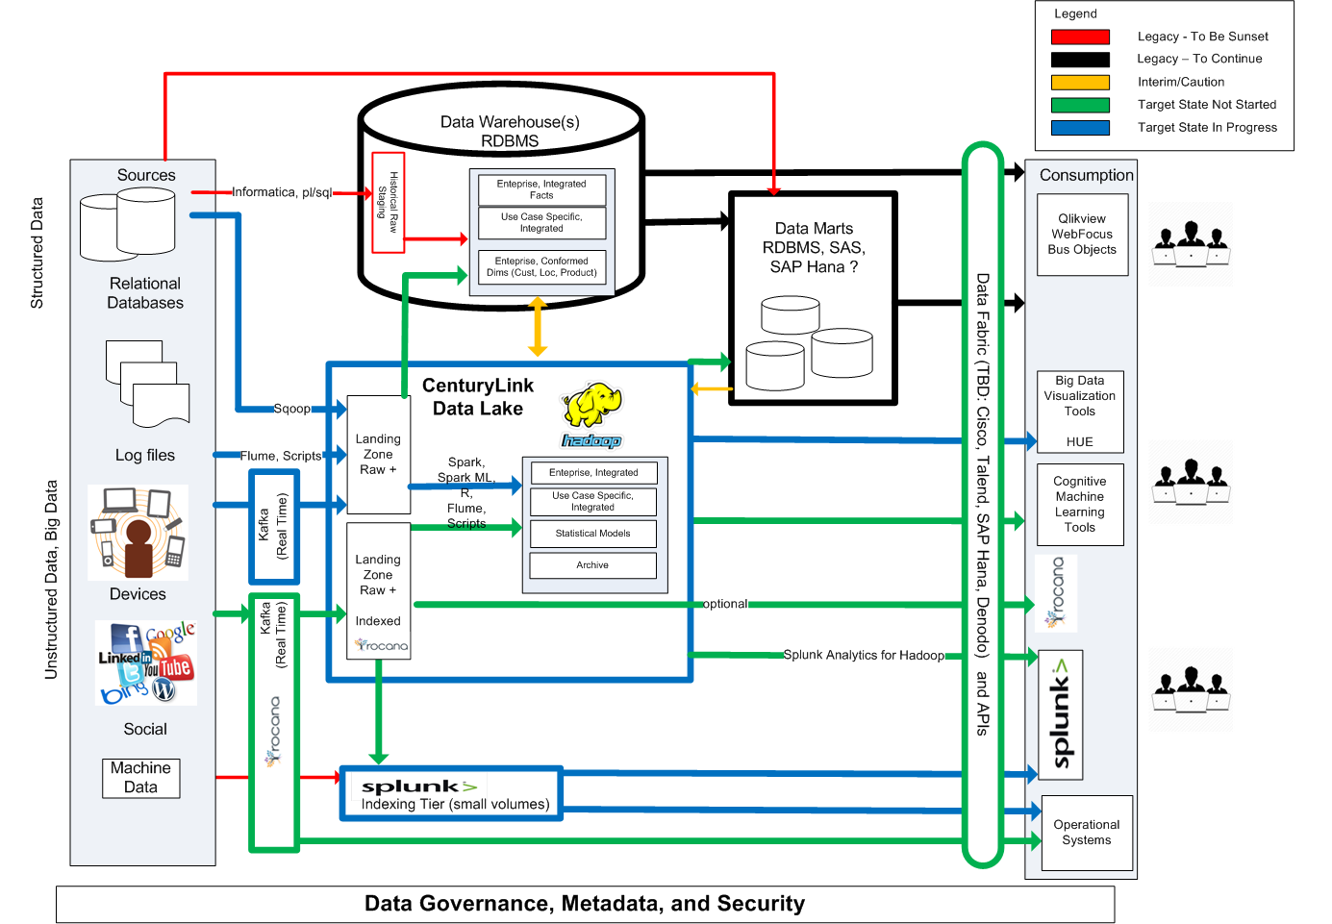
CenturyLink Big Data “Ecosystem”

